Slide 1
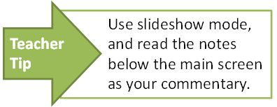
Shared roles and responsibilities within Australia’s federal system of government: An everyday example
State/Territory
Local
Federal

Slide 2


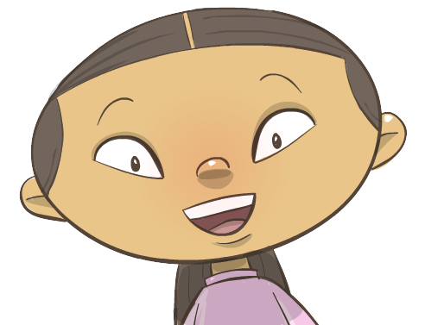
Three levels of government
There are three levels of government in Australia: federal, state/territory and local.
The three levels of government work together to serve the people of Australia.
Sometimes, two or three levels of government might share responsibilities.

Slide 3


Shared responsibilities
State/Territory
Federal
Here are some shared responsibilities between federal and state/territory governments.
Education: universities, colleges, grants to schools
Health: Medicare
Police: federal police
Education: primary and secondary schools
Health: hospitals
Police: state and territory police
If federal and state laws conflict on an issue, the federal law overrides state laws..

Slide 4

Scenario: Will’s day
Will rides his bike to school every day.
Last Tuesday, he fell off his bike and knocked his head because the bikeway he was riding on was uneven.
There were a lot of leaves and dirt on the path, which made it slippery.
Will’s mother called the ambulance to take him to the hospital.
Luckily, the hospital said he only had bruising and a few cuts.
After making a claim at Medicare, Will’s mother drove him back to school. Will’s mother called her local councillor to let her know that the bikeway is unsafe for children.
local government
The three colours show the different levels of government responsible for each service.
Discuss reasons for the sharing of responsibilities by governments.
state government
federal government

Slide 5
Services provided by government in Will’s day
Local facilities: provision of bike paths and maintenance of gardens and bikeways
local government
Transport: roads and traffic
Health: hospitals, ambulance
Education: schools
state government
Health: Medicare
Education: funding to states/ territories
federal government

Slide 6

Shared responsibilities of the three levels of government
Transport and health are just two examples where two or three levels of government might share responsibility.
Discuss other examples with a partner.

Slide 7
Attributions
Reference: Everyone’s parliament, www.parliament.qld.gov.au

